Slide 1


Prolog-based Student Course Advisor
Navyug Vidyabhavan Trust
C. K. Pithawala College of Engg. & Tech.
Computer Engineering Department
Course-Integrated Practical & Analytical Task (CIPAT)
Artificial Intelligence-3170716
Project
BE IV, Sem VIII
Presented By
Ms. Anishree Kamal Patwa
220090107005
Faculty Guide
Prof. Gira Barot
Asst. Professor

Slide 2
agenda
INTRODUCTION 3
PROBLEM STATEMENT 4
METHODOLOGY 5
QUERY DEMONSTRATION 6
CONCLUSION 11

Slide 3

Introduction

Slide 4
Introduction
Course selection is crucial for shaping academic & career growth.
Traditional advising is subjective and may not fully align with student goals.
AI provides a systematic, data-driven approach → reduces subjectivity.
Prolog: strong in predicate logic & rule-based reasoning → ideal for expert systems.
Rule-based advisor evaluates:
Academic percentage
Subject interests
Career aspirations
Benefits: transparent, consistent, and personalized recommendations.
Beyond course advising: AI used in education for
Personalized learning paths
Dropout prediction
Performance trend analysis
Shift from one-size-fits-all → adaptive, learner-centric education.

Slide 5
Problem Statement
& Objective

Slide 6
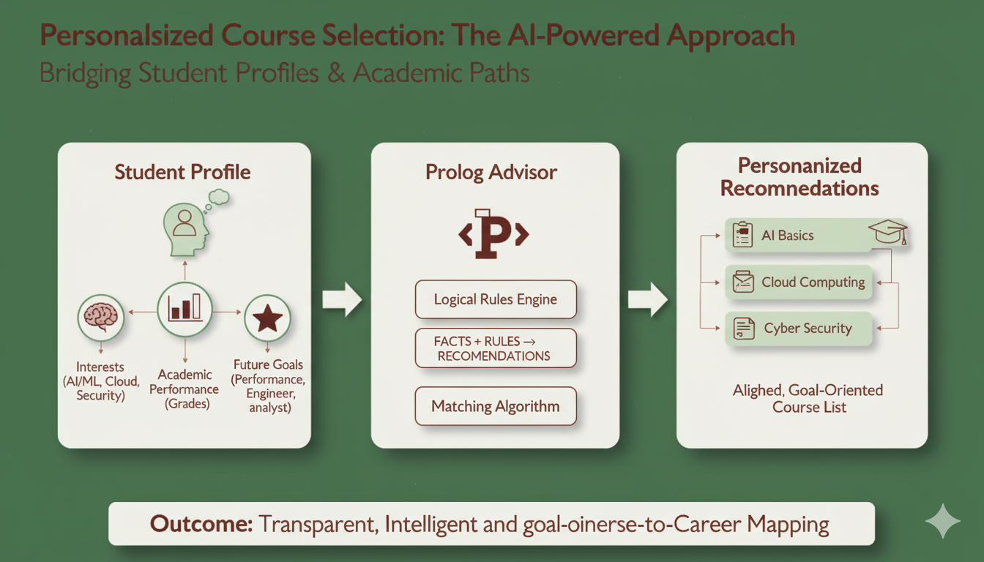
Students struggle to select electives that match their profile.
Key challenges :
Interests (AI, Cloud, Security, etc.)
Academic performance (marks/grades)
Future career goals (researcher, engineer, analyst)
Objective:
Build a Prolog-based Student Course Advisor
Uses facts, rules, and constraints to recommend electives
Ensures courses align with performance + interests + aspirations
Outcome: Transparent, logical, and goal-oriented course recommendations.

Slide 7
Methodology
Search Technique
Logic & knowledge representation
Ai application
System implementation

Slide 8
Search Techniques
How Prolog Uses DFS + Backtracking?
Prolog applies DFS internally for queries
Example: recommend_course(alice, Course)
Searches interested_in/2 facts
Matches with course/3 facts
Checks percentage eligibility
If conditions fail → backtracks to next option
Ensures all valid courses are recommended.
Depth-First Search (DFS) → explores one branch fully before moving to another
Backtracking → returns to previous step if a dead-end is reached
Steps in DFS:
Start at root (initial state)
Explore one branch completely
Backtrack on failure, try alternatives
Continue until solution(s) found
So basically,
Prolog tries each interest branch depth-first.
If a course is valid → recommended.
If a course fails eligibility → backtracks to next option.
Ensures all valid recommendations are found.

Slide 9
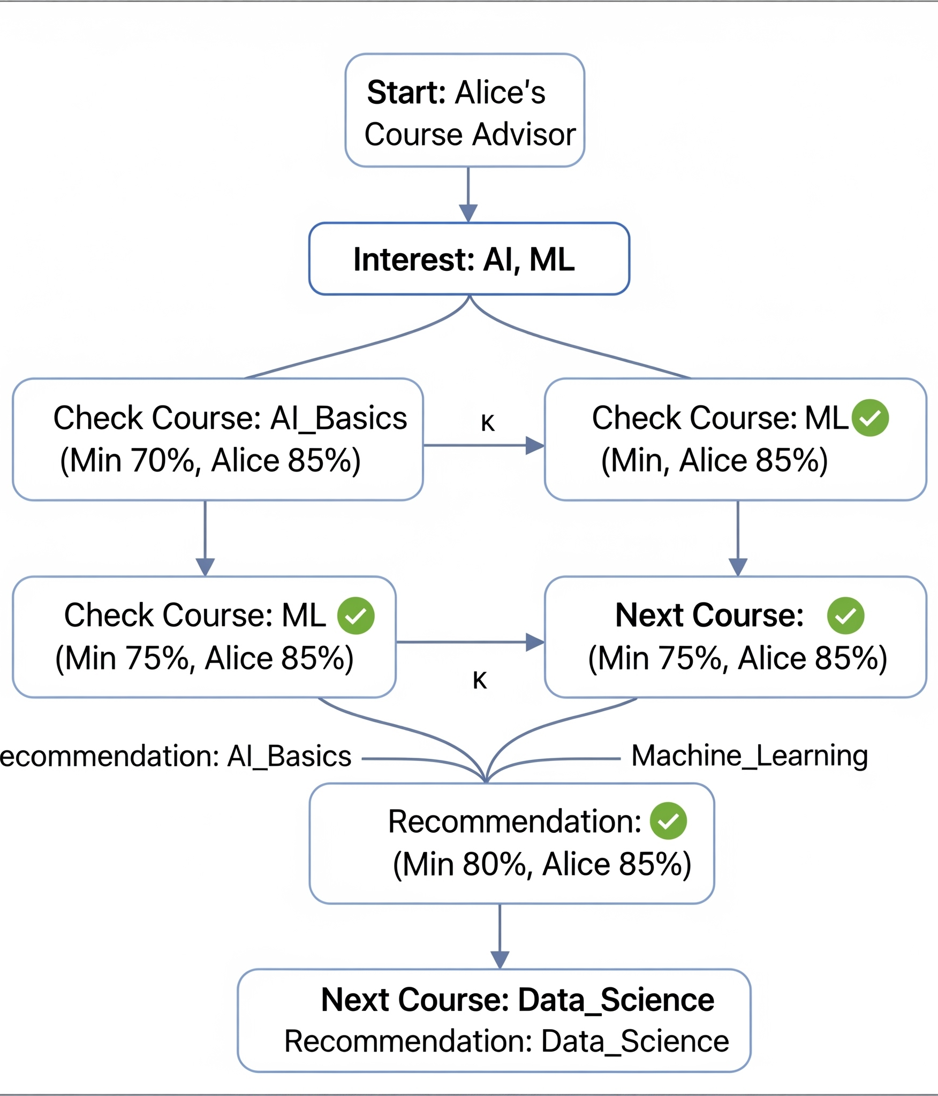
Example
Like lets say,
The system starts with Alice’s profile (marks, interests, goal).
Prolog explores each interest branch (AI, ML) using DFS + backtracking.
For each course, it checks the minimum percentage requirement.
If eligible → course is recommended.
After completing one path, Prolog backtracks to explore other options.
Final result: Alice gets AI_Basics, Machine_Learning, Data_Science.

Slide 10
System Implementation
Student Details & Printing
CSV Export
Utility Predicates
Knowledge Base
Recommendation Rules

Slide 11
Knowledge Base
Recommendation Rules
Stores facts about students, marks, interests, goals
Courses defined with minimum percentage
Interest + Percentage Match
Suggest course if interest + eligible marks
Goal-Aware Match
Suggest course if also aligned with career goal
Example Rule:
recommend_course(Student, Course) :-
student(Student),
interested_in(Student, Interest),
percentage(Student, Perc),
course(Course, Interest, MinPerc),
Perc >= MinPerc.
Example:
student(alice).
percentage(alice, 85).
interested_in(alice, ai).
goal(alice, researcher).
course(ai_basics, ai, 70).

Slide 12
Utility Predicates
CSV Export
get_interests/2 → Student’s interests
get_goal/2 → Career goal
suggest_courses/2 → List all valid courses
Export results for external use.
Example:
?- print_csv('students_summary.csv').
Example:
?- suggest_courses(alice, Courses).
Courses = [ai_basics, machine_learning, data_science].
Student Details & Printing
Search Techniques in Action
print_student_details/1 → Full details of one student
print_all_students/0 → Summary of all students
print_table/0 → Tabular format (easy read)
Prolog applies DFS + Backtracking
Tries all interests & courses → checks constraints
Ensures all valid recommendations are found

Slide 13
Logic & Knowledge Representation
Rule 1: Interest + Percentage Match
recommend_course(S, C) :-
student(S), interested_in(S, I),
percentage(S, P), course(C, I, M), P >= M.
Example: Alice (85%) interested in AI → eligible for ai_basics (70%) and data_science (80%)
Why it matters: Matches student’s interest + academic readiness
Rule 2: Goal-Oriented Recommendation
recommend_course(S, C) :-
student(S), interested_in(S, I), goal(S, G),
percentage(S, P), course(C, I, M), P >= M,
course_goal_match(C, G).
Example: Charlie (75%) → wants to be security expert → recommended cyber_security (70%)
Why it matters: Aligns career goals + interests + marks
Together: Rules make the advisor personalized, logical, and career-focused.

Slide 14
AI Applications in Education
1. Personalized Learning Paths
AI-driven adaptive systems suggest courses & study plans based on learner’s needs.
Factors: past performance, learning speed, preferences.
Example: Coursera, Khan Academy → recommend next lessons/exercises.
2. Dropout Prediction
ML models analyze attendance, grades, engagement patterns.
Identify at-risk students → enable early intervention.
Example: Universities use predictive analytics for counseling & support.
3. Performance Analytics
AI dashboards track real-time student progress.
Helps teachers identify weak areas, personalize feedback.
Example: Georgia Tech, Stanford → AI tutors & analytics dashboards.
Impact: AI in education → smarter decisions, reduced dropout, improved learning outcomes.

Slide 15
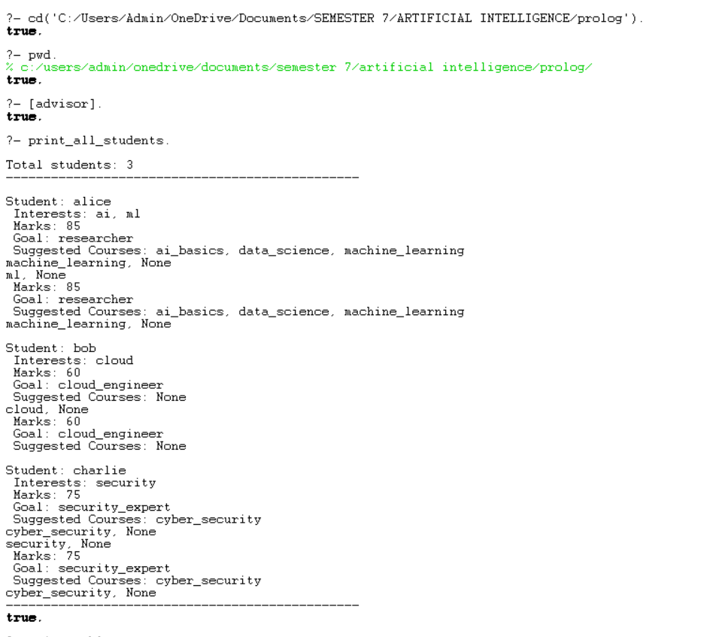
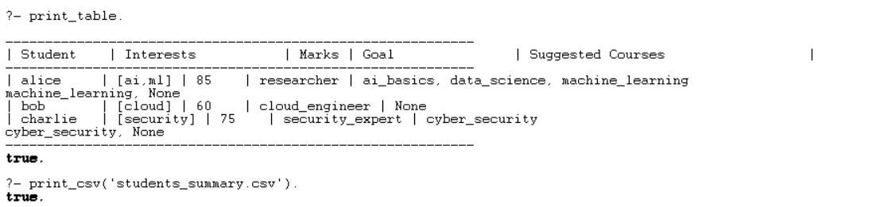
Query Demonstration
The system was tested using SWI-Prolog queries.
Queries performed included:
Retrieving suggested courses for a specific student.
Checking recommendations based on interests + goals.
Printing all student details in table format.
Results:
The system produced accurate, personalized elective suggestions.
Validated the correctness of rules & knowledge representation.

Slide 16
Comparison with Modern Systems
Prolog-based System
Uses explicit logical rules (percentage, interests, career goals).
Provides clear reasoning & transparency.
Modern AI Systems (Coursera, edX, university dashboards)
Use Machine Learning for:
Personalized learning paths
Dropout prediction
Performance analytics
Provide adaptivity & scalability with big data.
Key Difference
Prolog → Explainable, rule-based decisions.
Modern AI → Adaptive, data-driven insights.
Together
Rule-based → Best for structured, small-scale advising.
ML-based → Best for dynamic, large-scale platforms.

Slide 17
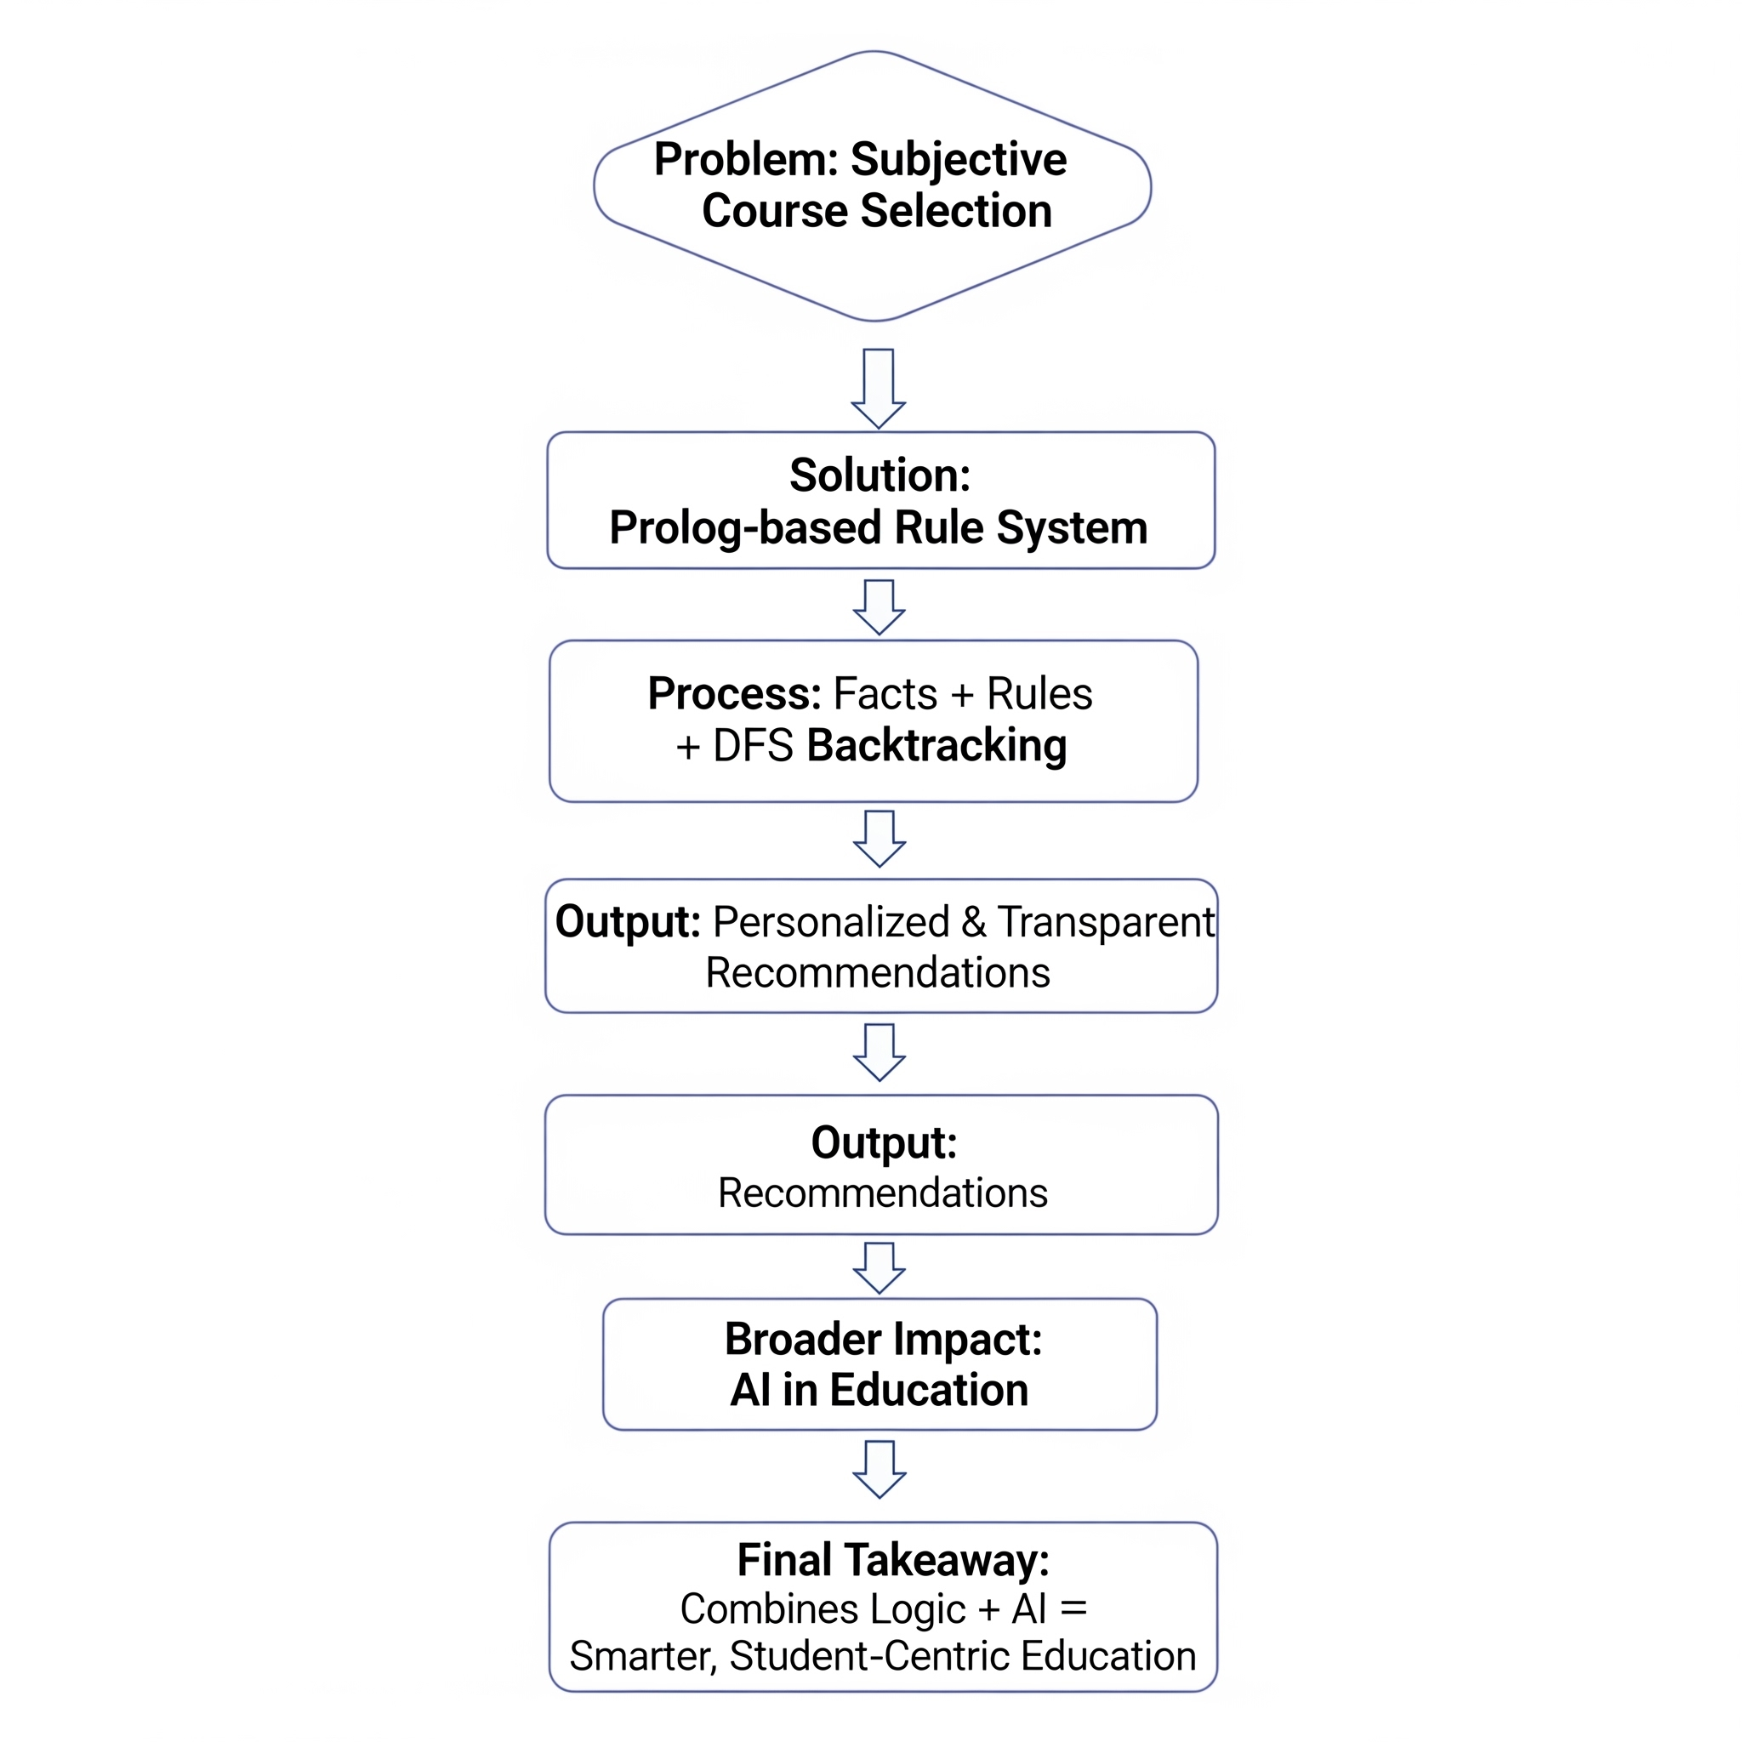
Conclusion
The Prolog-based Student Course Advisor successfully recommends elective courses by applying logical rules, constraints, and backtracking search. The project highlights the effectiveness of predicate logic and search techniques in solving real-world decision-making problems within education.
This work also demonstrates how AI applications can bring structure, transparency and personalization to academic advising.
Future Scope :
The system can be further enhanced by integrating machine learning models to provide data-driven recommendations, adapting to dynamic student data and offering real-time advising support similar to intelligent tutoring systems used in modern universities.

Slide 18
Thank You
Any questions??

